Slide 1
Normative Ethics II: Challenges to Principle-Based Ethics
Class 14
Philosophy 100
Introduction to Philosophy

Slide 2
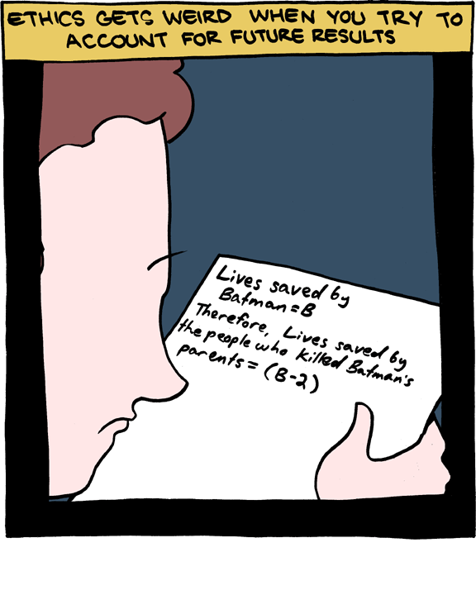
Consequentialism
Consequentialism argues that the morality of an action is contingent on the action's outcome or consequence.
Thus, a morally right action is one that produces a good outcome or result, and the consequences of an action or rule generally outweigh all other considerations (i.e. the ends justify the means).

Slide 3
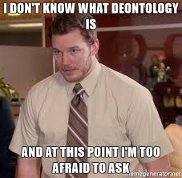
Deontology
Deontology (or Deontological Ethics) focuses on the rightness or wrongness of actions themselves, as opposed to the rightness or wrongness of the consequences of those actions or to the character and habits of the actor.
To a Deontologist, whether a situation is good or bad depends on whether the action that brought it about was right or wrong. What makes a choice "right" is its conformity with a moral norm: Right takes priority over Good.

Slide 4
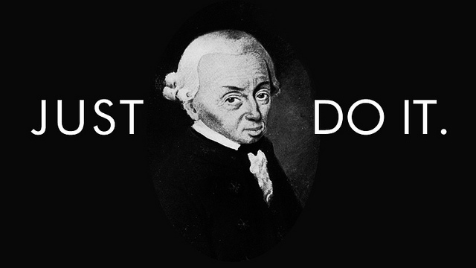
Kant's Categorical Imperative
An act A is morally permissible iff
(1) A could be willed to be universal and
(2) A does not use people as mere means but as ends in themselves.

Slide 5
The First Maxim Test
Suicide
Maxim: Out of self love, I will end my life because it is too painful to continue.
This is contradictory because that thing which is to promote a better life would in fact be to end life.
Letting one’s talents fade
Maxim: When I have a talent, I do not need to use it.
This is contradictory because if everyone who had a talent didn’t use it, then no one would have talents. One need to exercise one’s abilities to have talent.
Lying
Maxim: When I am short of money and need it, I can borrow some without intending to pay it back, even if I say that I will pay it back.
This is contradictory because the act of promising would be thereby null of meaning if there were times when keeping one's promise was negotiable.
Withholding help from those who need it
Maxim: Whenever I see someone in need who I can assist I needn't help.
This is contradictory, because if universalized it would mean no one needs to help me if I am in need, and yet we all desire help when we are in need of it.

Slide 6
Second Maxim in Action
Suicide
I would be using myself as a means to my own end. I would be using someone as a mere means, and this would undermine the second maxim.
Development of one's talents.
If we don’t develop our talents, we use ourselves as a mere means.
Lying.
Lying is also using someone as a means and not an end in themselves because lying is a way to get the person to do something for my ends.
Helping other's flourish.
If we fail to help others flourish, we treat them as mere means.

Slide 7
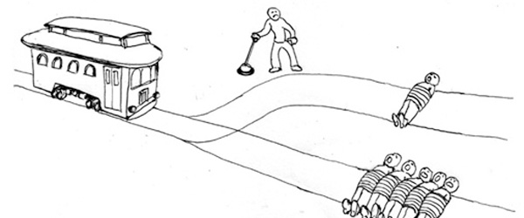
The Trolley Problem

Slide 8
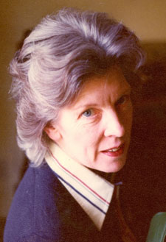
Philippa Foot (1920 – 2010)
British philosopher, most notable for her works in ethics.
A founder of contemporary virtue ethics.
Some of her work was crucial in the re-emergence of normative ethics within analytic philosophy, especially her critique of consequentialism.
Introduced the trolley problem.

Slide 9
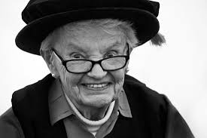
Judith Thomson (b.1929)
American moral philosopher and metaphysician.
She is known for her defense of moral objectivity, her account of moral rights, her views about the incompleteness of the term 'good,' and her use of thought experiments to make philosophical points.

Slide 10
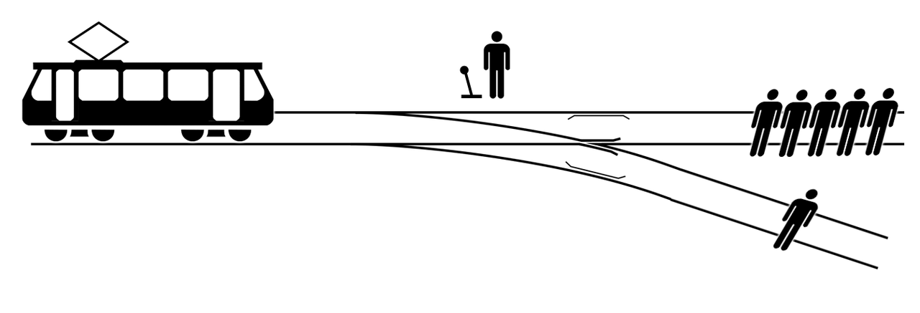
The Trolley Problem
There is a runaway trolley barreling down the railway tracks. Ahead, on the tracks, there are five people tied up and unable to move. The trolley is headed straight for them. You are standing some distance off in the train yard, next to a lever. If you pull this lever, the trolley will switch to a different set of tracks. However, you notice that there is one person on the side track.
You have two options:
Do nothing, and the trolley kills the five people on the main track.
Pull the lever, diverting the trolley onto the side track where it will kill one person.
Which is the most ethical choice?

Slide 11
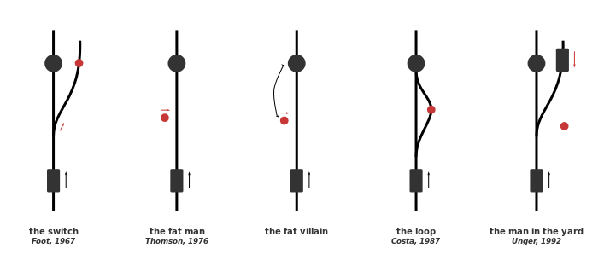
Variations on the Trolley Problem

Slide 12

The Transplant Problem
Imagine you’re a great surgeon. Among other things you do, you transplant organs, and you are such a great surgeon that the organs you transplant always take. At the moment you have five patients who need organs. Two need one lung each, two need a kidney each, and the fifth needs a heart. If they do not get those organs today, they will all die; if you find organs for them today, you can transplant the organs and they will all live. A young man who has just come into your clinic for his yearly check-up has exactly the right blood-type, and is in excellent health. Lo, you have a possible donor. All you need do is cut him up and distribute his parts among the five who need them. You ask, but he says, "Sorry. I deeply sympathize, but no."
Would it be morally permissible for you to operate anyway?

Slide 13
Trolley versus Transplant
What is the morally relevant difference between the Trolley Problem and the Transplant Problem?
Is there a moral difference between killing and letting die?
Do rights trump utilities?
What about the right to life for the innocent track worker?

Slide 14
Supreme Moral Principles
Golden Rule:
Positive: Do unto others as you would have them do unto you.
Negative: Don’t do to others what you wouldn’t want done to yourself.
Kant:
Act upon those principles that can be universalized without contradiction; treat people as ends in themselves.
Mill:
The right act will bring about the greatest pleasure for the greatest number of people.

Slide 15

How do we apply such principles to both Trolley and Transplant Problems?
Golden Rule
??
Kant:
Don’t flip the switch.
Mill:
Flip the switch—all things being equal.

Slide 16
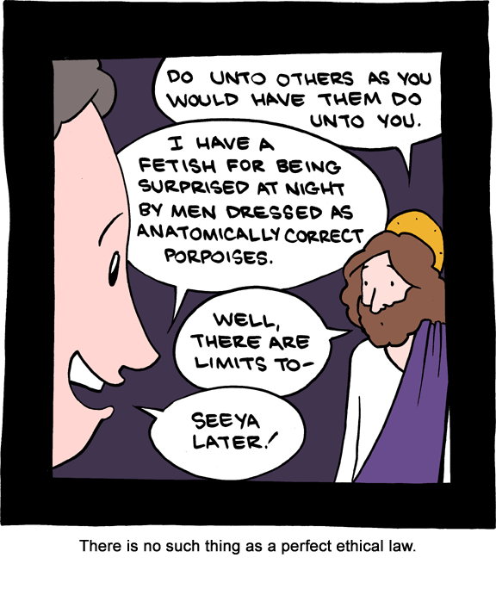
Supreme Moral Principles: Problems
The golden rule can still allow for actions that seem wrong: some people make like pain inflicted upon them.
Kant’s maxims can produce contradictory result and some acts that seem wrong.
Mill’s view seems to mandate actions that seem wrong—liking killing one for the pleasure of many.

Slide 17
What the principles tell us.
We can’t seem to find a supreme moral principle. Each has a counterexample.
We discover in our counterexamples, however, that morality requires that we consider other’s interests and not only our own.
“When sympathy is missing, morality rests on practicality.”

Slide 18


